Slide 1

Linear Regression of AAPL on SPY daily return

Slide 2
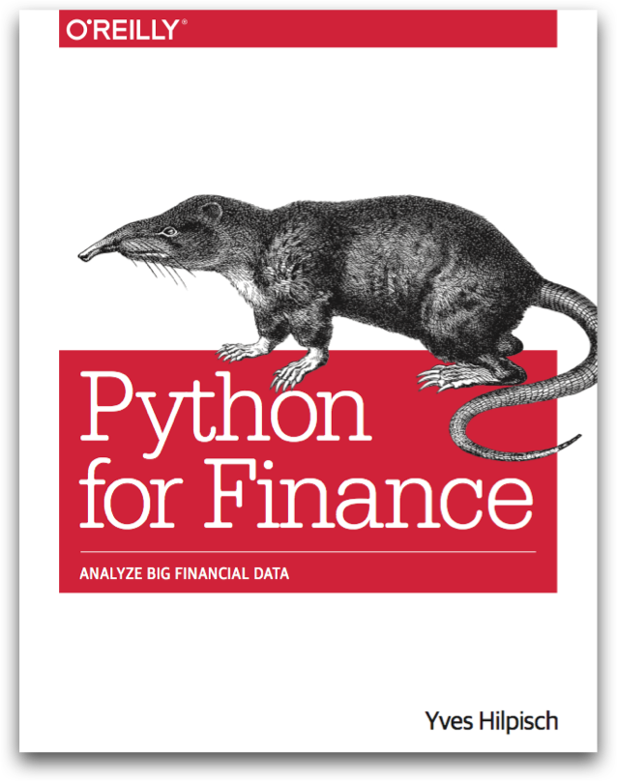
Reference
Python for Finance (O'Reilly)
Youtube
Code

Slide 3
Data

Slide 4
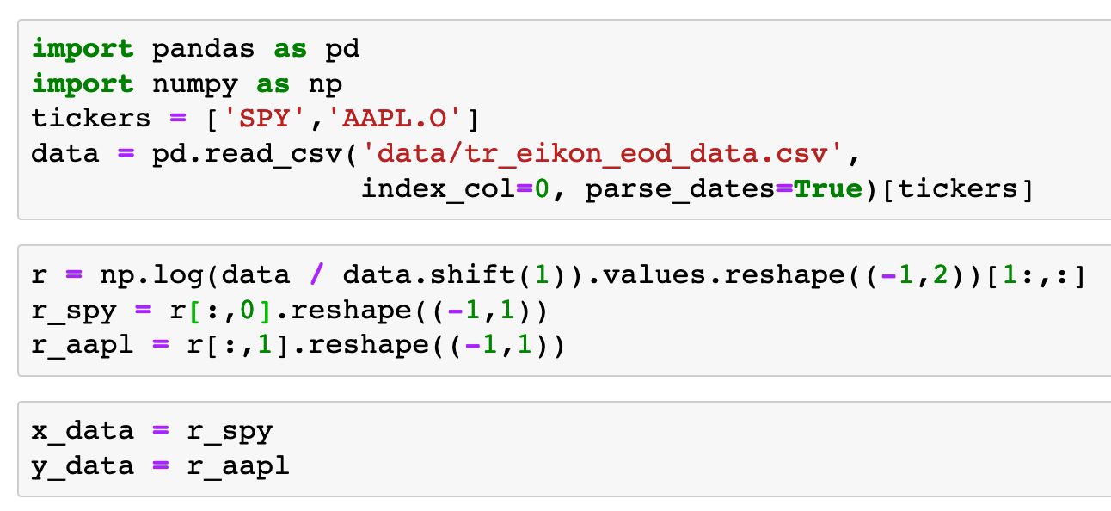


Slide 7
Graph

Slide 8
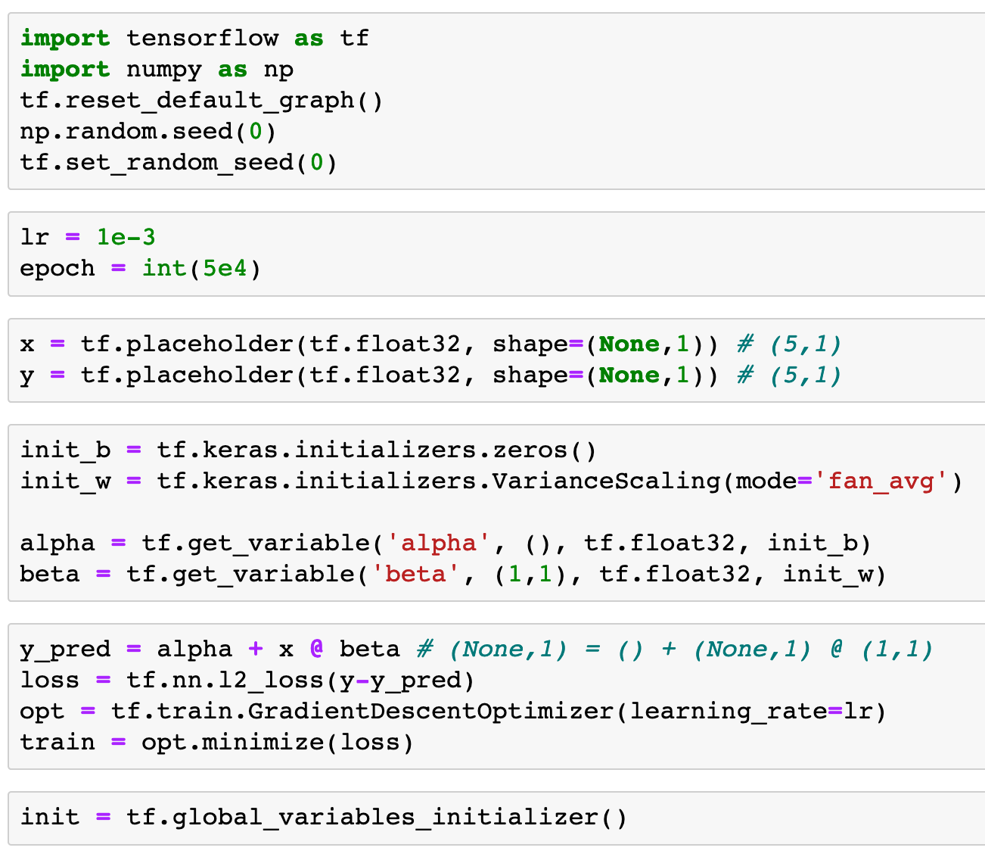

Slide 14
Session

Slide 15
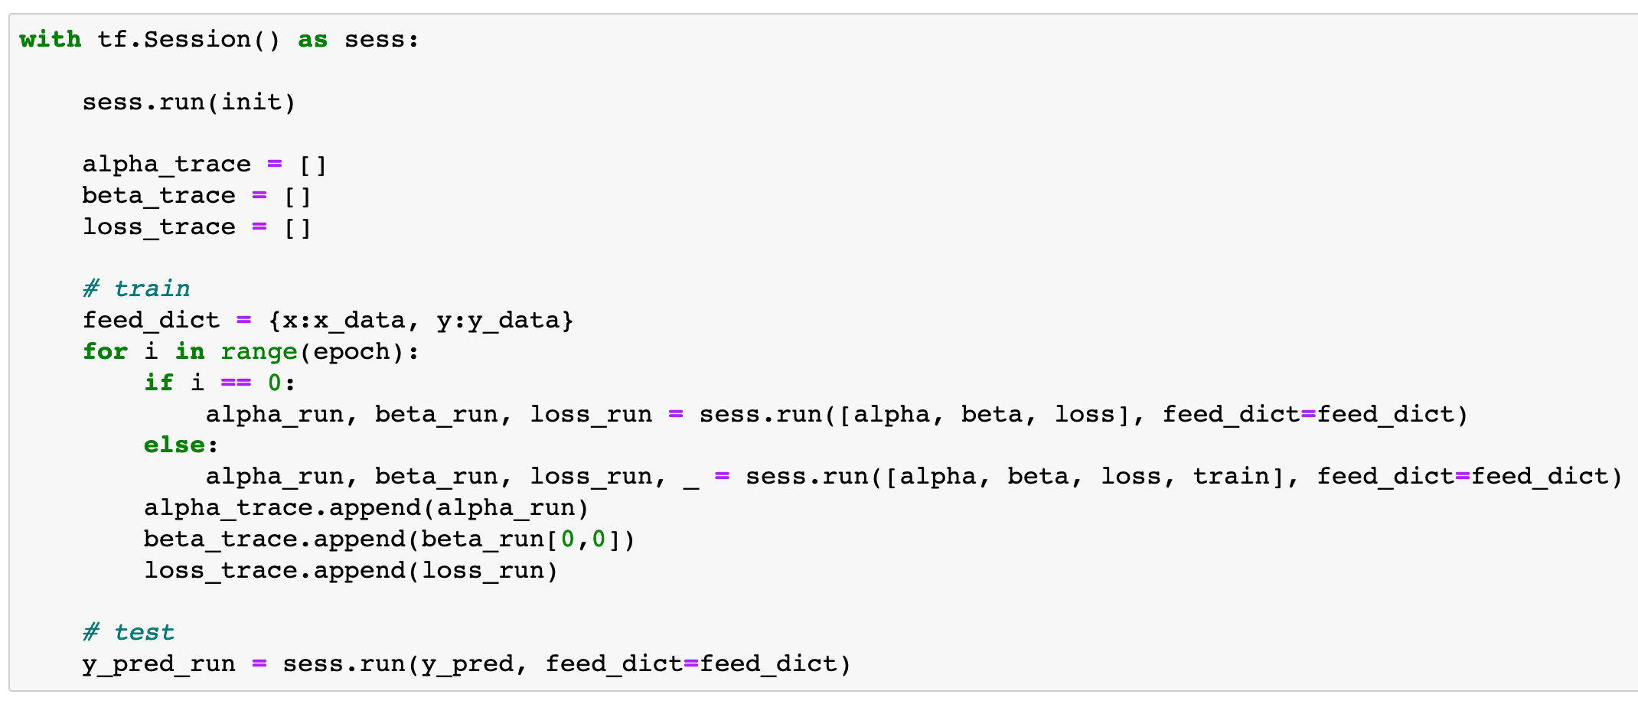

Slide 16
Report

Slide 17
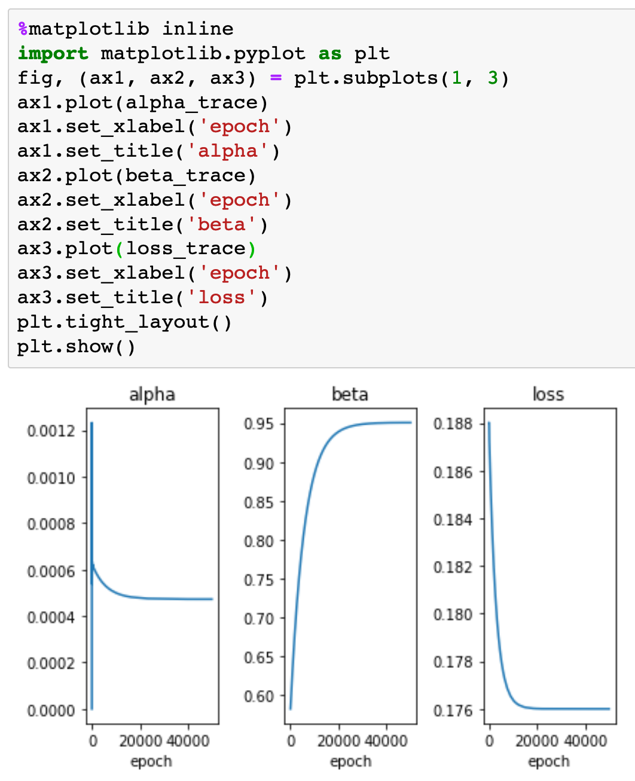

Slide 18
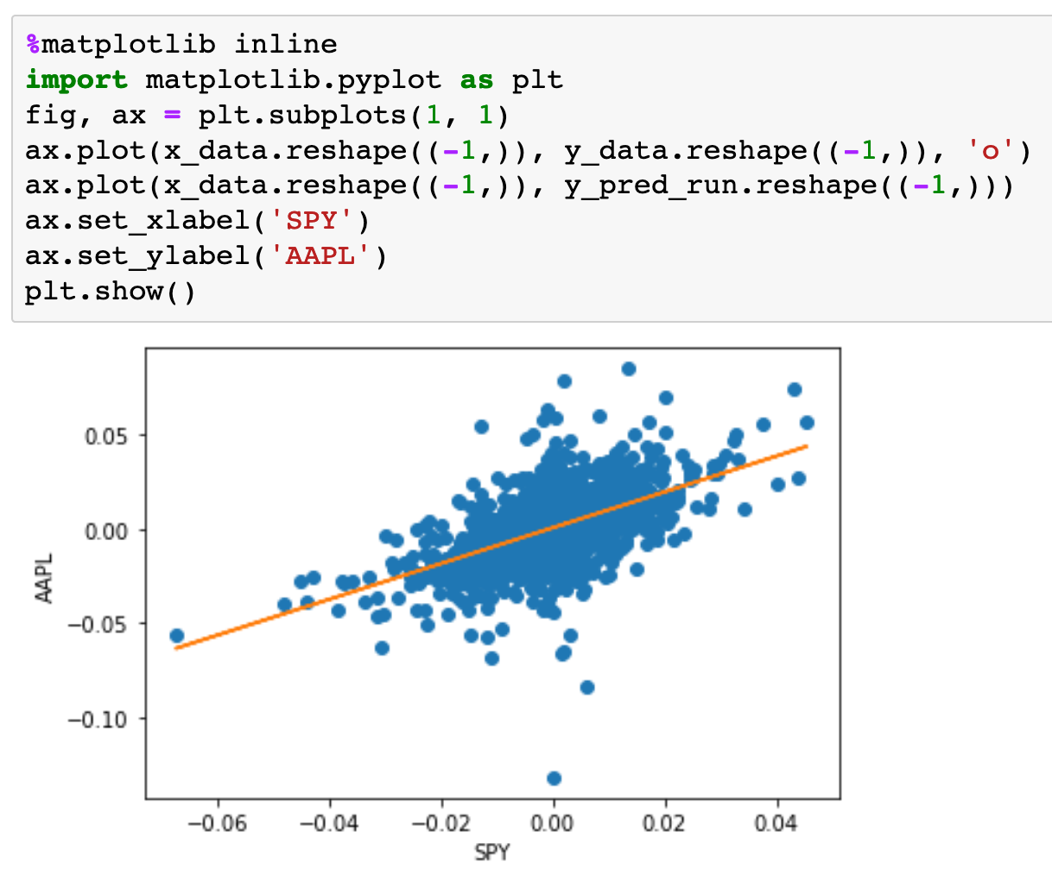

Slide 19
Now
Let’s Play with Code

